Slide 1

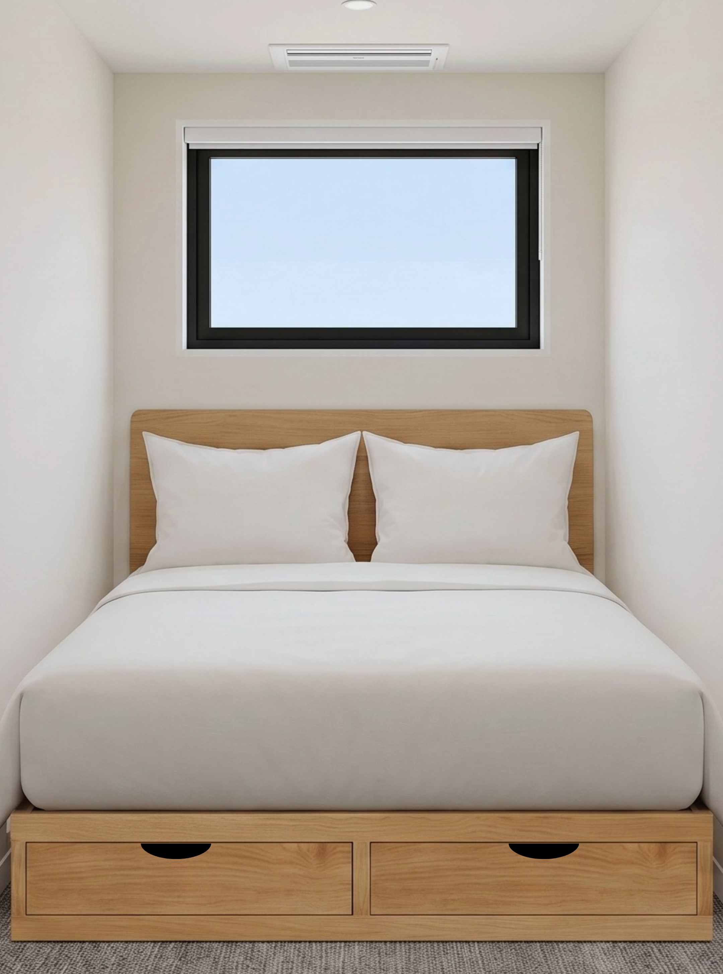

Sleep Space
A hotel built
like a product.
Lower build cost. Leaner operations.
A network guests can subscribe to.
INVESTOR PRESENTATION • 100-ROOM PROTOTYPE
Sleep Space - sleepspace.net

Slide 2
THE ECONOMIC ENGINE
59% less gross area per key
The rate stays in the budget tier. The building footprint does not.
CURRENT 100-KEY CASE
SLEEP INN PROTOTYPE
181.5 GSF / key
444.8 GSF / key
18,151 GSF total
37,363 GSF / 84 rooms
$83 Year 1 ADR
2.45x revenue density
100 rooms
at equal room revenue / key
SLEEP SPACE - INVESTMENT OPPORTUNITY
02
Notes:
[Sources]
- Sleep Space Las Vegas - 10-Year Underwriting Model (Current), Project Summary: 18,150.74 GSF / 100 keys = 181.51 GSF/key; Year 1 ADR = $83.37.
- Choice Hotels Sleep Inn Prototype & Design Package: 84 rooms and 37,363 building GSF. https://www.choicehotelsdevelopment.com/sfsites/c/cms/delivery/media/MC66PQE3OF6BHMFFCZ7IQLY4YL5M
- Calculation: 37,363 / 84 = 444.80 GSF/key; 181.51 is 59.2% lower. At equal room revenue per key, 444.80 / 181.51 = 2.45x room-revenue density per building square foot. This is a mathematical illustration, not operating history.

Slide 3
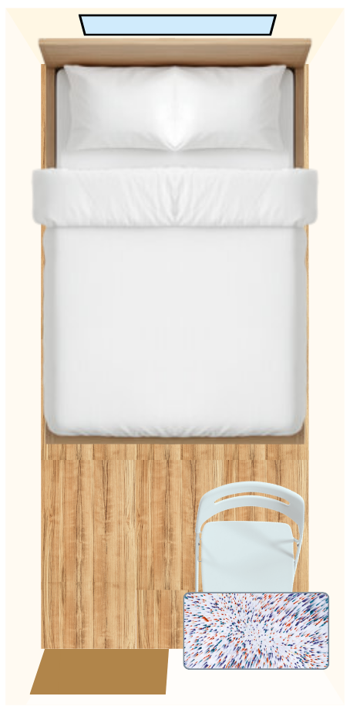
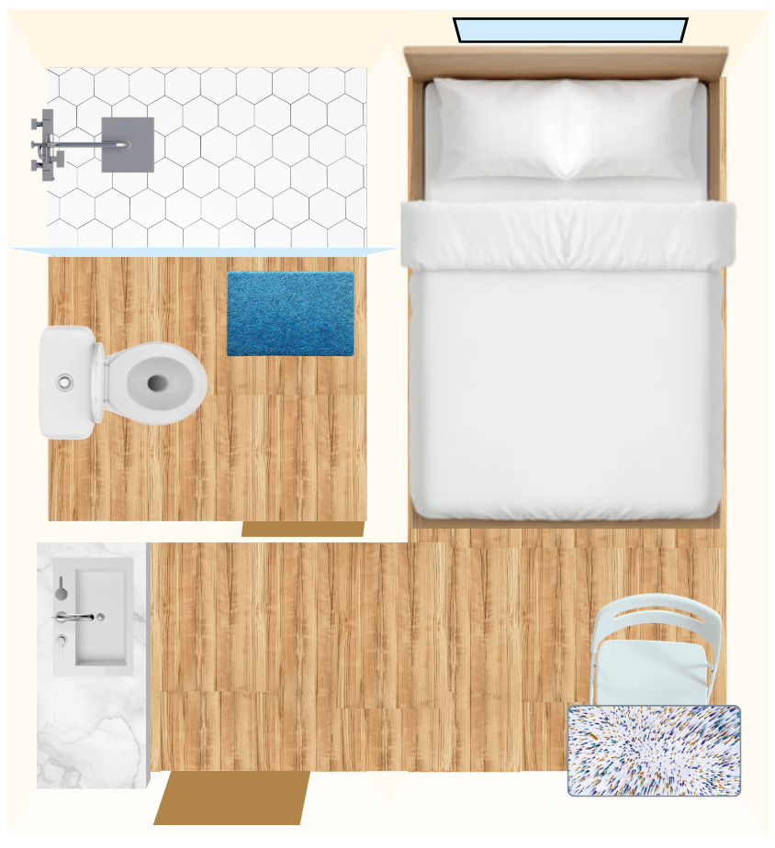
THE CONCEPT
Two room tiers create a clear price ladder
One national price architecture. Local inventory controls protect each property.
Economy
$59 anchor
Economy Plus
$89 anchor
Entry price that earns trial
Trade-up for space + privacy
Full XL bed • Private room
Full XL bed • Private bath
The anchor attracts demand. The upgrade captures willingness to pay.
SLEEP SPACE - INVESTMENT OPPORTUNITY
03
Notes:
[Sources]
- Internal Sleep Space pricing architecture and current website room plans.
- Marriott citizenM FAQ: consistent compact-room experience as a sector precedent. https://www.marriott.com/brands/citizenm/faqs.mi

Slide 4
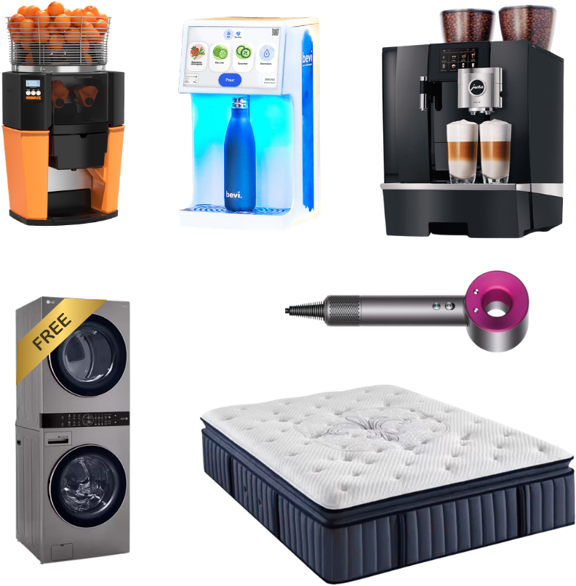
REINVEST THE SAVINGS
Spend less on square feet. More on every touchpoint.
Smaller rooms lower build, clean and replacement costs. Savings go into durable furniture and a better night's sleep.
Long-life mattress + replaceable sleep components
Hotel-grade linen and 600 GSM towels
Durable, easy-clean furniture and finishes
Safe, quiet controls and fast Wi-Fi
Good coffee + free laundry on longer stays
BUY BETTER ONCE Replace less. Protect the guest experience.
SLEEP SPACE - INVESTMENT OPPORTUNITY
04
Notes:
[Sources]
- Internal Sleep Space FF&E, OS&E and guest-experience strategy.

Slide 5
THE BUILD ADVANTAGE
Three levers lower the cost to open
Standardize the shell, the supply chain and the room.
1 LIVIO BUILDING SYSTEM
2 FACTORY-DIRECT SUPPLY
Closed-wall panels
Factory to site
Pre-engineered • repeatable
More work moves off site
Direct China sourcing • consolidated QC
3 SMALLER ROOMS
Less space to build • less space to clean
SLEEP SPACE - INVESTMENT OPPORTUNITY
05
Notes:
[Sources]
- Internal Livio closed-wall planning scope: PROJECT_CONTEXT.md and sleep-space-main-sync/public/docs/fdd/fdd_preview.html.
- Internal factory-direct consolidation and QC workflow: sleep-space-main-sync/public/supply-catalog.js.
- McKinsey, Modular construction: From projects to products (2019). Benefits depend on repeatability, early design commitment, logistics and scale. https://www.mckinsey.com/capabilities/operations/our-insights/modular-construction-from-projects-to-products

Slide 6
THE VALUE CHAIN
Own more of the stack. Capture more of the upside.
Sleep Space integrates the asset, the product and the customer relationship.
PROPERTY
PRODUCT
OPERATE
DEMAND
REAL ESTATE
BUILD + BUY
CRASH PAD
BRAND + MEMBERS
Own or control each hotel
Livio, rooms and procurement
Pricing, access and room turns
Direct booking + partner demand
ONE ECONOMIC SYSTEM
More value stays inside the company - from land acquisition to the next booking.
SLEEP SPACE - INVESTMENT OPPORTUNITY
06
Notes:
[Sources]
- Internal Sleep Space ownership and operating thesis.
- citizenM ESG Report 2021 disclosed a fully integrated real-estate development, design/project-management and hotel-operating model as a sector precedent. https://assets.citizenm.com/images/ESG_report_2021-2.pdf

Slide 7
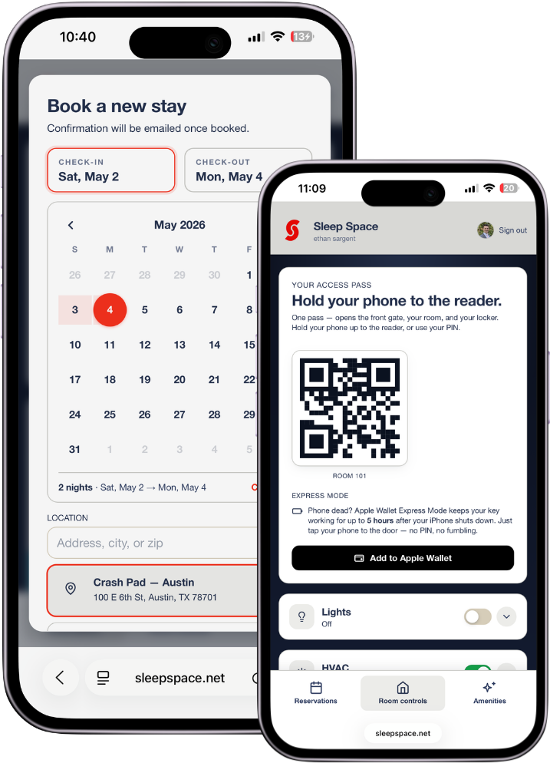
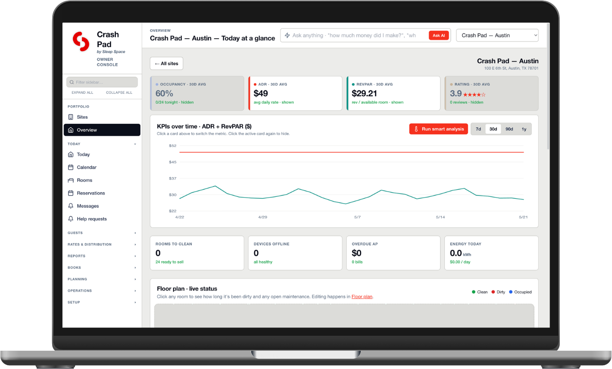
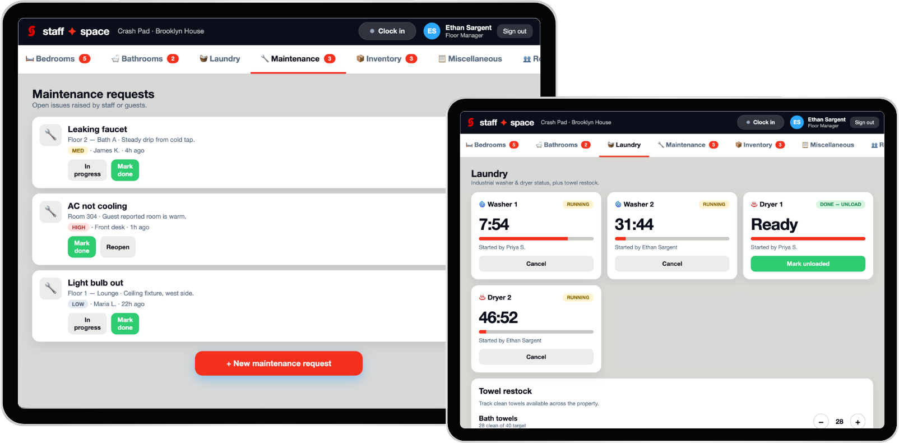
THE OPERATING SYSTEM
One platform runs every property
Crash Pad connects guests, staff and owners so standards scale before corporate overhead does.
GUEST APP
FLEET CONSOLE
STAFF APP
Book, check in, unlock
Price, monitor, optimize
Clean, inspect, maintain
SLEEP SPACE - INVESTMENT OPPORTUNITY
07
Notes:
[Sources]
- Internal Crash Pad, guest app and staff app product screenshots and operating workflows.

Slide 8
THE SCALE ADVANTAGE
A local cluster makes every hotel cheaper to run
Standard rooms make labor portable. Density unlocks shared cleaning, laundry, maintenance and purchasing.
ONE PROPERTY
LOCAL CLUSTER
One room-turn playbook
Central laundry hub
Cleaning minutes tracked
Shared mobile cleaning teams
Onsite linen + supplies
Route-based maintenance
Local maintenance coverage
Bulk purchasing + replenishment
SLEEP SPACE - INVESTMENT OPPORTUNITY
08
Notes:
[Sources]
- Internal Sleep Space cluster-operations thesis. Central hubs are future options subject to route density and unit economics.

Slide 9
DEVELOPMENT COST
A structurally lower cost per key
Smaller rooms, a standardized shell and direct sourcing change the denominator.
$84.9K
$170K
$197K
50%-57%
SLEEP SPACE
HVS LOW END
HVS HIGH END
MODELED GAP
Current modeled uses / key
Limited-service median
Midscale extended-stay median
Below the HVS range
THE THESIS
Smaller footprint • Livio shell • direct sourcing
Preliminary model versus a national survey; project scope, land and market conditions vary.
SLEEP SPACE - INVESTMENT OPPORTUNITY
09
Notes:
[Sources]
- Sleep Space Las Vegas - 10-Year Underwriting Model (Current): $8,494,300 total uses / 100 keys = $84,943 per key.
- HVS U.S. Hotel Development Cost Survey 2026: limited-service and midscale extended-stay median per-room development costs of approximately $170,000 to $197,000. https://www.hvs.com/article/10509-hvs-us-hotel-development-cost-survey-2026
- Calculated gap: $84,943 is approximately 50.0% below $170,000 and 56.9% below $197,000.
- The comparison is preliminary and not like-for-like; HVS cautions that location, product and scope materially affect project costs.
[/Sources]

Slide 10
CURRENT UNDERWRITING
The prototype is built for capital efficiency
The current case turns 18,151 GSF into 100 keys.
100
18,151
$84.9K
22.3%
ROOMS
TOTAL GSF
USES / KEY
LEVERAGED IRR
50 Economy / 50 Economy Plus
181.5 GSF / key
Current underwriting
10-year modeled
CURRENT PROTOTYPE CASE
100 keys • $8.49M uses • $2.97M equity • projections, not operating history
SLEEP SPACE - INVESTMENT OPPORTUNITY
10
Notes:
[Sources]
- Sleep Space Las Vegas - 10-Year Underwriting Model (Current), Project Summary.
- Current modeled case: 100 keys, 18,150.74 GSF, $8,494,300 total uses, $84,943 uses per key, $2,973,005 equity, and 22.329% leveraged IRR.
- All figures are pro forma projections based on assumptions that may change; they are not operating history or a guarantee of future performance.

Slide 11
THE MARKET SCREEN
A disciplined buy box for the first nodes
Start where demand is healthy, rates support the product and short stays repeat.
65%+
$90+
DIGITAL
SHORT
OCCUPANCY
MARKET ADR
GUEST MIX
STAYS
Healthy demand before adding supply
Rate room above the modeled $83 ADR
Younger-skewing, phone-first demand
Transient, repeatable room nights
SCREEN, THEN UNDERWRITE
Third-party market study • competitive set • site-level feasibility
SLEEP SPACE - INVESTMENT OPPORTUNITY
11
Notes:
[Sources]
- User-provided initial market screens: 65%+ occupancy, $90+ market ADR, younger/digital-first guest mix, and shorter lengths of stay.
- These are preliminary screens, not acquisition criteria or a substitute for third-party market, feasibility, zoning, site, and underwriting diligence.
[/Sources]

Slide 12
THE NETWORK MODEL
Membership becomes the flywheel - after density
The first hotel works alone. The network unlocks recurring demand.
DAY ONE
AT NETWORK SCALE
Two price anchors
Members + partners
Simple public rates
No mandatory fee
Low member rates • prepaid partner room blocks
NETWORK FLYWHEEL
Prepaid demand → financeable cash flow → more hotels → stronger membership
SLEEP SPACE - INVESTMENT OPPORTUNITY
12
Notes:
[Sources]
- citizenM mycitizenM+ offers a paid annual membership with hotel discounts. https://www.citizenm.com/mycitizenmplus-threemonthsfree
- Ennismore Dis-loyalty offers a paid network-wide membership with hotel and food discounts. https://dis-loyalty.com/content/about/
- United completed $6.8B of MileagePlus-secured financing in 2020; this is a scale analogy only, not a Sleep Space relationship or commitment. https://www.sec.gov/Archives/edgar/data/100517/000110465920080673/tm2024018-1_8k.htm
- Sleep Space membership and prepaid partner demand are future concepts subject to product-market fit, contracts and underwriting.

Slide 13
LEADERSHIP & ADVISORS
A team built around the hard parts
ES
GP
NA
Ethan Sargent
Greg Posmantur
Navneet Aron
FOUNDER & INTEGRATOR
HOTEL OPERATIONS
BUILD SYSTEM
Combines brand, real estate, product and Crash Pad into one operating company.
Limited-service standards, openings and operating discipline across 30+ hotel brands.
Livio founder; panelized delivery, engineering and repeatable construction.
SLEEP SPACE - INVESTMENT OPPORTUNITY
13
Notes:
[Sources]
- Internal team biographies and current Sleep Space advisor roles.

Slide 14
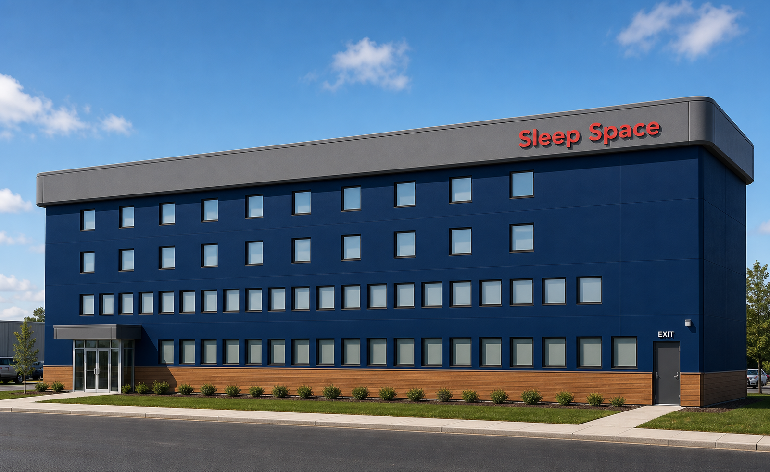
Sleep Space
Fund the first node.
Build the network.
CAPITAL
MILESTONE
CONTACT
Seed + first-project equity
Open the 100-room prototype
ethan.sargent@sleepspace.net
IMPORTANT NOTICE Confidential, for discussion only - not an offer to sell or a solicitation to buy any security. Figures are pro forma projections, rest on assumptions that may change, and are not a guarantee of future performance. Prospective investors should conduct their own diligence.
Notes:
[Sources]
- Internal capital-raise positioning. Final amount and structure remain subject to site control, project scope and lender terms.

